Slide 1

The assembly of most massive galaxies seen by Shards and Candels
Paola Dimauro, Marc Huertas-Company, Emanuele Daddi, Pablo Pérez González
GEPI, Observatory of Paris

Slide 2
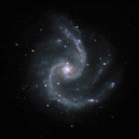
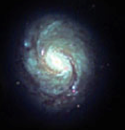
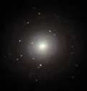




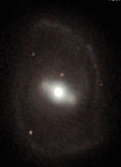
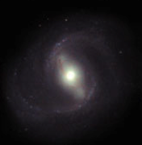
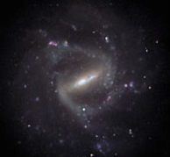
Hubble sequence
Sb
Sa
Sc
S0
Spiral galaxies
E0
E5
SB0
Elliptical galaxies
SBb
SBa
SBc

Slide 3
Aim of the work
How the massive end of the Hubble (~10¹¹M_{sun}) sequence emerges and evolves from z~3
GOODS/CANDELS
4 optical bands
3 infrared bands
SHARDS
24 otpical bands
Detailed stellar population of bulges and disks
Notes:
it will help constraining when and how bulges formed.

Slide 4
MegaMorph
The MegaMorph project has produced new versions of Galapagos and Galfit
Multi-wavelenght mode
Bulge + disk decomposition
GalapagosM
Sextractor
GalfitM
Output catalogue
Parameters values
Coefficients of the function
[MegaMorph, Haeussler et al., 2013]
Notes:
in BAND values and in CHEB values .
the CHEB values describe the polynomial directly
the BAND values are derived from this polynomial

Slide 5
CANDELS data
Sersic index
R (arcmin)
Wavelenght (nm)
Wavelenght (nm)
Z=0.36
magnitude
Wavelenght (nm)

Slide 6
CANDELS data
Interpolated values for Shards bands
x Hst
Sersic index
Wavelenght (nm)
magnitude
Wavelenght (nm)

Slide 7
CANDELS+SHARDS data
Magnitude
Z=0.36
x HST
* SHARDS
Wavelenght (nm)

Slide 8
Morphologies of the galaxies
Reconstruct the visual morphological classification :
Disk dominated
Bulge dominated
Bulge+disk
[Huertas-Company 2015]
Notes:
I want to see the different morphologies of the different type of galaxies. To do that selected tree class of objects using the visual morphologie catalogue that Marc present yesterday.

Slide 9
Disk [Sph = 0.02 Disk = 1.00]
x HST
* SHARDS
Magnitude
Z=0.3
Wavelenght (nm)
Notes:
Linea del Mg = 435
Linea del OI =870

Slide 10
Bulge [Sph = 0.997 Disk = 0.144]
Magnitude
Z=1.07
x HST
* SHARDS
Wavelenght (nm)

Slide 11
Bulge + Disk [Sph = 0.74 Disk = 0.960]
Magnitude
Z=0.560
x HST
* SHARDS
Wavelenght (nm)

Slide 12
Future work…
Run the software on the entire sample
Photometrical and morphological analysis of the sample with bulge + disk decomposition
Detailed SEDs of bulges and disks will provide an accurate stellar populations parameters and help constraining formation mechanisms.

