Slide 1
SF timescale from [alpha/Fe]
SNII release most alpha –elements
SNIa release most Fe-peak elements

Slide 2
Other proposed possibilities
(1) A variable IMF
(2) Differential retention of Mg vs Fe in conjunction with galactic winds.
That one or more varies systematically with mass give us clues about massive galaxy formation.

Slide 3
Variation of [alpha/Fe] with mass in local galaxies
Thomas et al. 2005

Slide 4
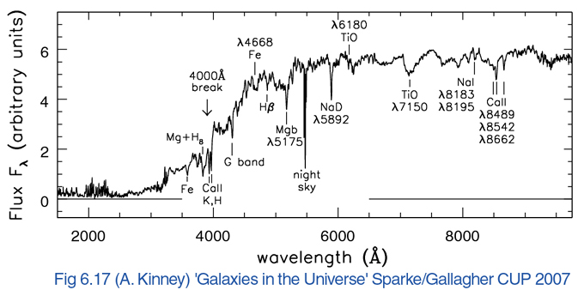
In the local Universe

Slide 6
Vazdekis et al. (2015) [α/Fe] models

Slide 7
The differences are larger at old ages

Slide 8
The differences are larger at high metallicities

Slide 9
Notes:
Esto es a redhisft 1.0

Slide 10
[Z/H]=-1.49
[Z/H]=-0.66
[Z/H]=0.06
[Z/H]=0.40
[α/Fe] = 0.4
[α/Fe] = 0.0
Notes:
Amarillo [alpha/Fe] enhanced.

Slide 11
[α/Fe] = 0.4
[α/Fe] = 0.0

Slide 12
[α/Fe] = 0.4
[α/Fe] = 0.0

Slide 15
[α/Fe] = 0.4
[α/Fe] = 0.0

Slide 20
Notes:
F772-F941 (quiza poner… tiene bastante sensitivity to alpha/fe pero hay que conocer edad y metalicidad.
F789-F883 (no depende de alpha)

Slide 22
Problems
At ages < 1 Gyr is going to be difficult to measure
[alpha/fe]

Slide 23
For the higher redshift galaxies

Slide 27
Evolution of the metallicity gradient in disk galaxies
The issue of the time evolution of the metallicity gradient is far from being unsettled (e.g., Chiappini et al. 2001; Hou et al. 2000).
Models of chemical evolution: the difference is the efficiency of the SF and the nature of the material (primordial or enriched) falling form the halo.

Slide 28
Evolution of the metallicity gradient with redshift: numerical simulations
The evolution is basically due to the efficiency of the feedback
Gibson et al. 2013

Slide 29
Evolution of the metallicity gradients: MW
Friel et al. 2002
Magrini et al. 2008

Slide 30
Evolution of the metallicity gradient with redshift
The evolution is basically due to the efficiency of the feedback
Gibson et al. 2013

Slide 31
Poor resolution flattens the (gas-phase) metallicity gradient
Yuan et al. 2013

Slide 32
But this is not true for the stellar metallicity gradients

