Slide 1
Universidad Complutense de Madrid,
First SHARDS Team Meeting
Madrid 20-21/06/2013
Properties of SFGs at intermediate redshift
selected from SHARDS
Antonio Cava
Universidad Complutense de Madrid, Spain
(soon @ Geneva Observatory, Switzerland)
PI: Pablo G. Pérez-González
SHARDS team: G. Barro, A. Cava, M. Balcells, N. Cardiel, J. Cenarro, J. Cepa, S. Charlot, A. Cimatti, C. Conselice, E. Daddi, J. Donley, D. Elbaz, I. Ferreras, J. Gallego, R. Gobat, R. Guzmán, A. Renzini, G. Rieke, J.M. Rodríguez-Espinosa, L. Tresse, I. Trujillo, V. Villar, J. Zamorano

Slide 2
SHARDS: Survey for High-z Absorption Red and Dead Sources
TALK OUTLINE
Introduction
Survey and data characteristics (see Pablo’s talk)
Origin and relevance of Els as SF indicator
- ELGs selection from SHARDS data
ELGs properties from [OII]
Conclusions

Slide 3
SHARDS: current status
Cat. V. 1.14.2
WEB VERSION
Cat. V. 1.13.2
Used for the analysis

Slide 4
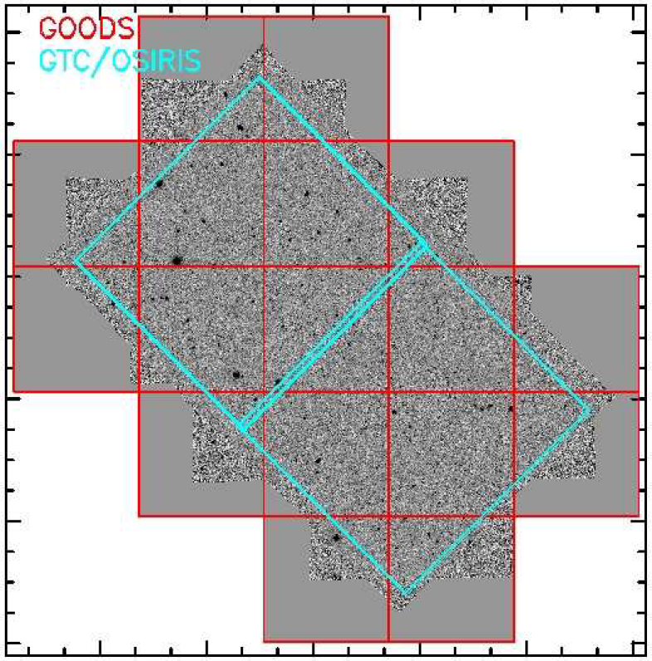
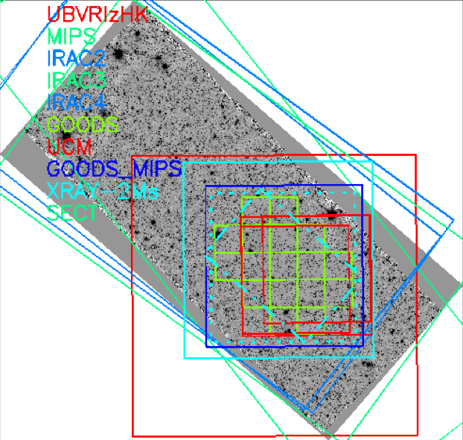
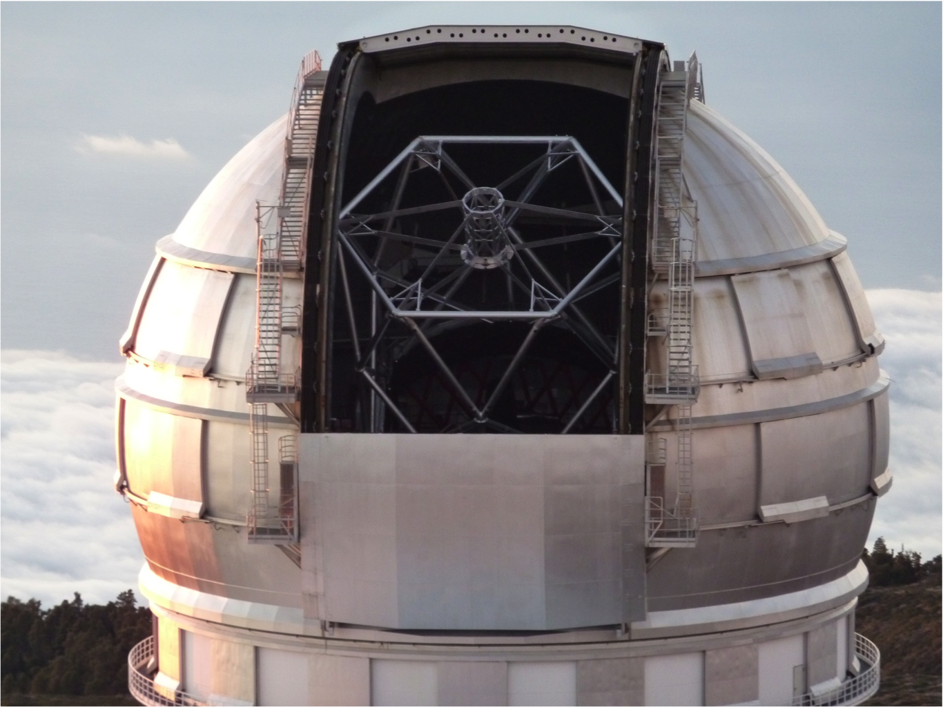
SHARDS: observations
Some GOODS reasons to target the GOODS-N field:
Extremely extended multi-wavelenght coverage: from X-rays to radio → well sampled SEDs
very good spectroscopic coverage (necessary for photo-z calibration and specific flux calibration issues)
observable from 10m class telescope, GTC, with OSIRIS instrument

Slide 5
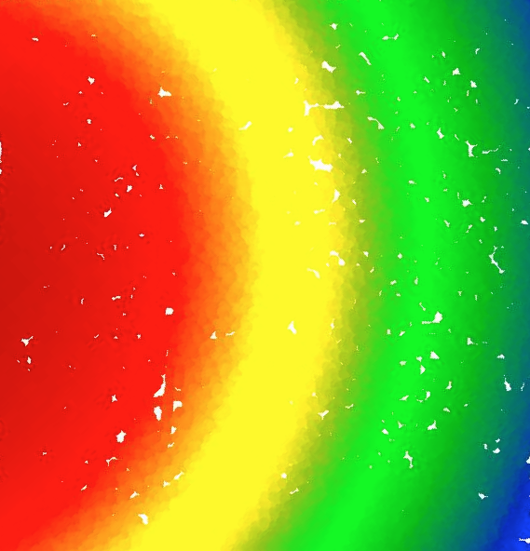
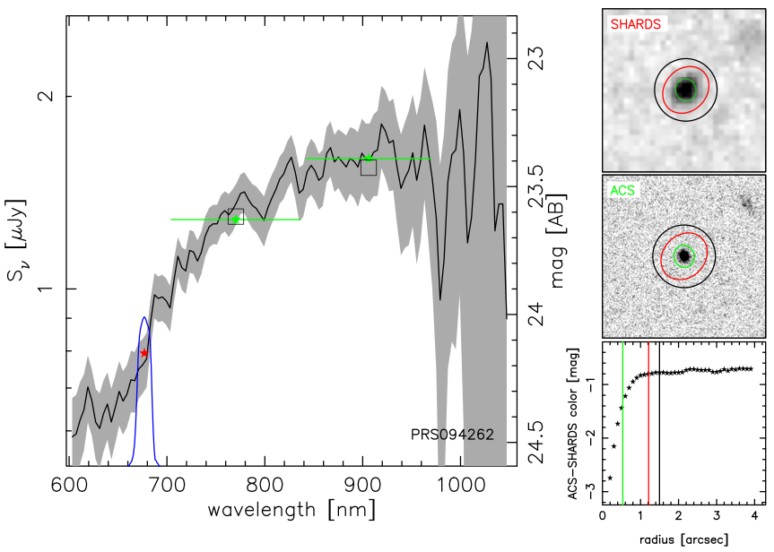
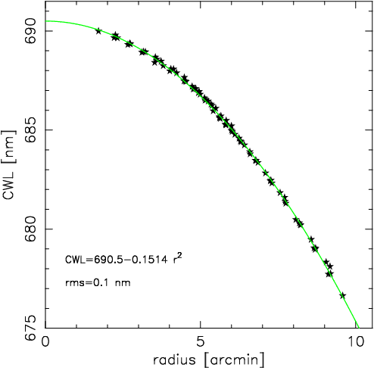
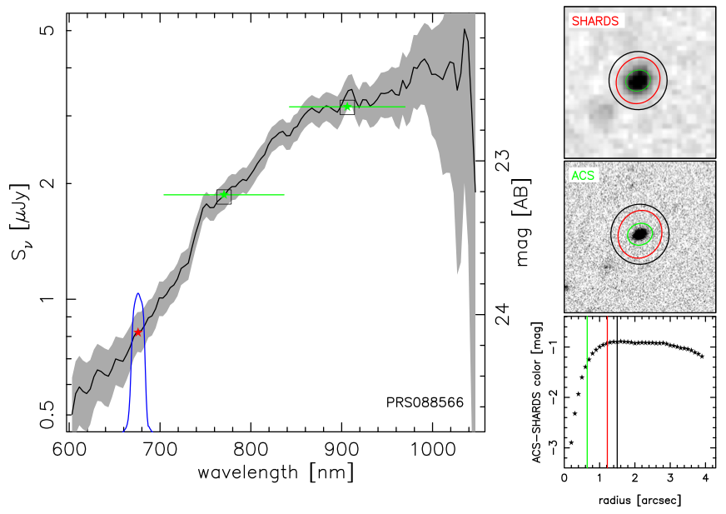
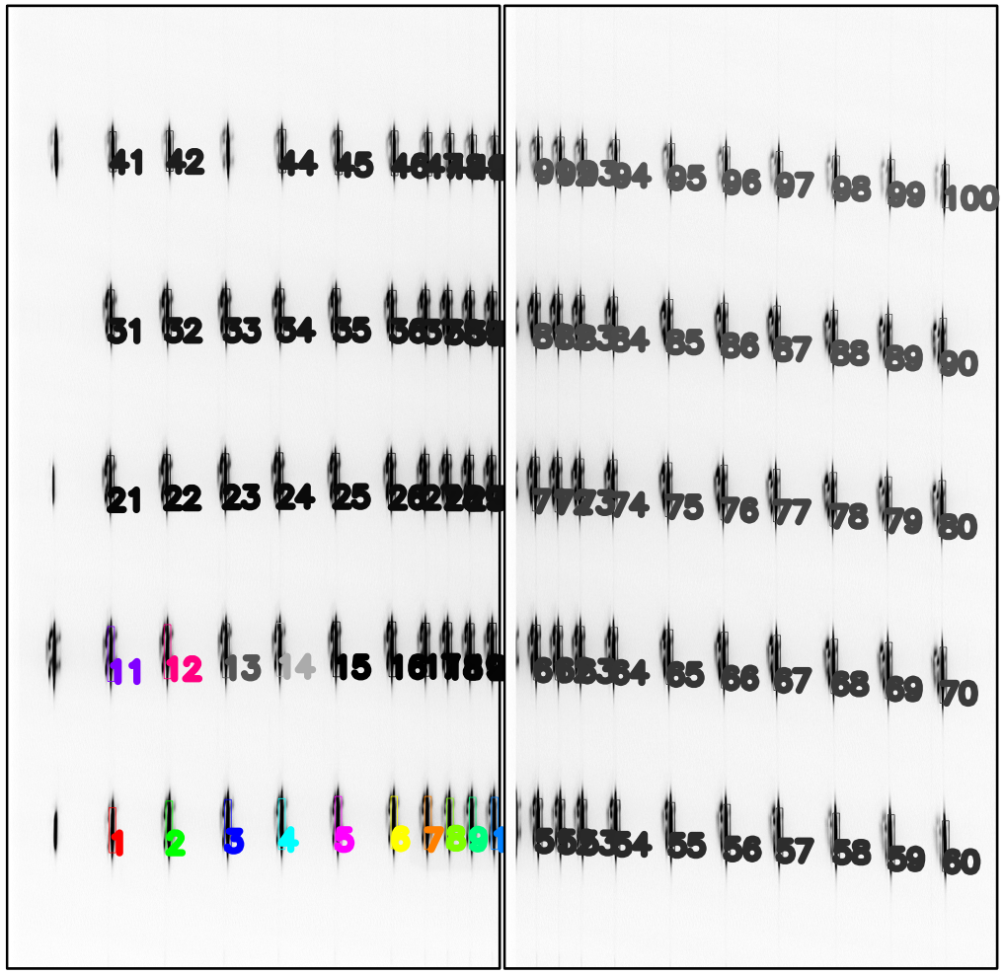
SHARDS: calibrations
CWL vs FOV position
Flux calibration (HST grism spectra + TKRS/DEEP3 + models)

Slide 6
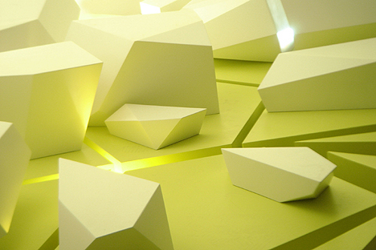
Shards of SHARDS
MgUV
Environment
Galaxy
satellites
ELGs
Ly-α
emitters
AGNs

Slide 7
Shards of SHARDS: SFGs/ELGs
What and why is it important?
ELGs are good tracers of SF
How has the Universe built up its stellar and metal content?
High-z formation efficiency?
Loz-z formation efficiency?
Z=0 → use the Hα luminosity density of the local Universe:
L_{D}(Hα) → SFRD(z=0) (e.g. Gallego et al. 1995)
Z>0 → use other optical/UV SF indicators from deep/large spectro-photometric surveys of Distant Galaxies to compute the Luminosity Density:
L_{D}(Γ,z) → SFRD(z) (e.g. Madau et al. 1996)

Slide 8
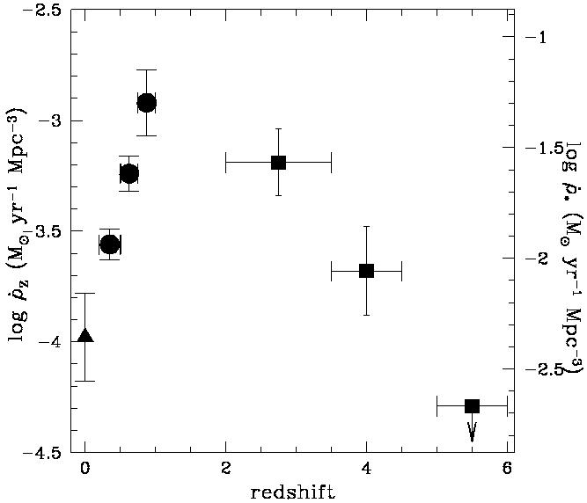
Shards of SHARDS: SFGs/ELGs
What and why is it important?
Age
Madau+98
SFRD
The star (and element) formation history of the universe, from the HDF (Madau 1998). The early data used for this figure indicated a strong peak in the SFR at about z ~ 1-2.

Slide 9
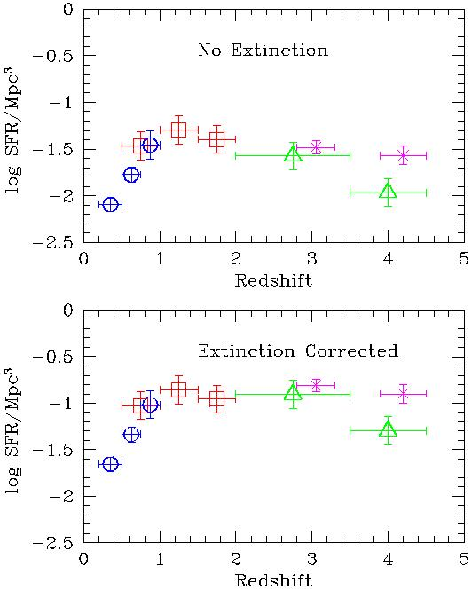
Shards of SHARDS: SFGs/ELGs
What and why is it important?
The star (and element) formation history of the universe, from the HDF (Steidel 1999). The data used for this figure indicated a weak peak in the SFR at about z ~ 1-2 followed by a flat behavior.

Slide 10
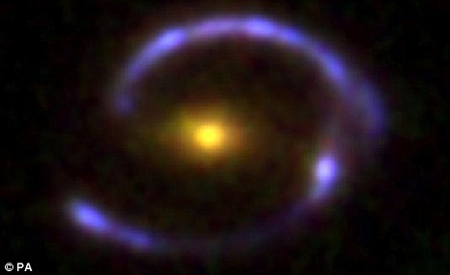
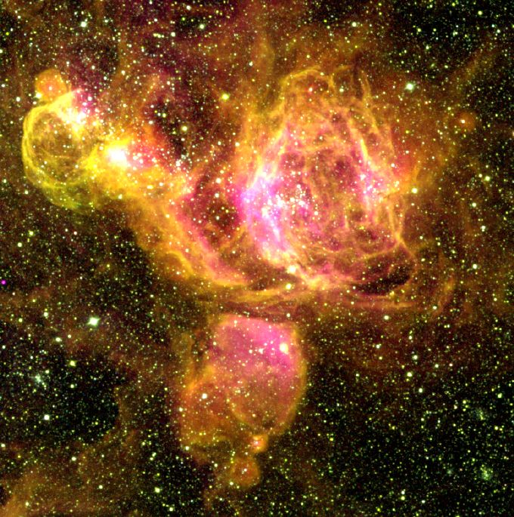
Shards of SHARDS - Science: ELGs
Why to study ELGs?
Young, bright stars are usually embedded in clouds of gas which are photoionized by energetic photons from these stars.
[OIII]
Hα
[OII]
The nebular lines effectively re-emit the integrated stellar luminosity of galaxies shortward of the Lyman limit, so they provide a direct, sensitive probe of the young massive stellar population.
Only stars with masses of >10 M and lifetimes of t<20 Myr contribute significantly to the integrated ionizing flux, so the emission lines provide a nearly instantaneous measure of the SFR, independent of the previous star formation history.
Most applications of this method have been based on measurements of the Hα line
but other lines/methods can be used as well.

Slide 11
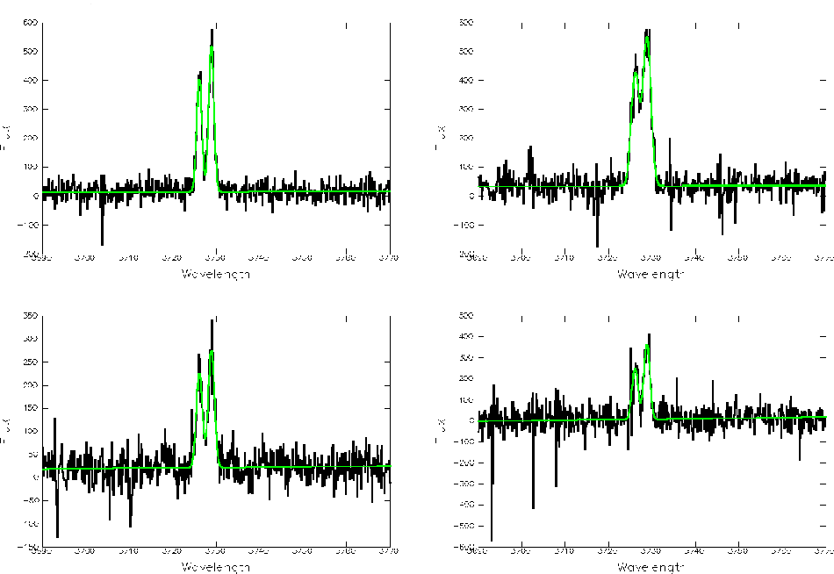
Shards of SHARDS – Science: [OII] and SF
Why to use [OII]?
The Hα emission line is redshifted out of the visible window beyond z≈0.5, so bluer SFR tracers can provide a very useful estimate of the systematics of SFRs in samples of distant galaxies.
The strongest emission feature in the blue is the [OII]λ3727 forbidden-line doublet.
(The ₂D^{3/2}→₄S^{3/2} and ₂D^{3/2}→₄S^{5/2} transitions give rise to the 3726.1 Å and 3728.8 Å emission lines respectively. )

Slide 12
Shards of SHARDS – Science: [OII] and SF
Why to use [OII]?
The lumnosity of the [OII] forbidden line is not directly coupled to the ionizing luminosity and is sensitive to abundance and the ionization state of the gas, but can be empirically calibrated (through Hα) as a quantitative SFR tracer.
SFR(Myear⁻¹)=(1.4±0.4)×10⁻⁴¹L[OII] (erg s⁻¹) (Kennicutt 1998)
Other important SFR tracers include:
- UV radiation (dominated by young star radiation field, SFR scales linearly with luminosity; 1500-2500Å from ground only at z>1; extinction is an issue, t~10⁸yr)
- MIR/FIR re-radiation (fraction of UV radiation absorbed by dust and re-emitted in the mid-/far-IR, t~10⁹yr)
- integrated colors (e.g. U-V; imprecise and model dependent but provide average SFR properties for large galaxy samples, t>10⁹y)

Slide 13
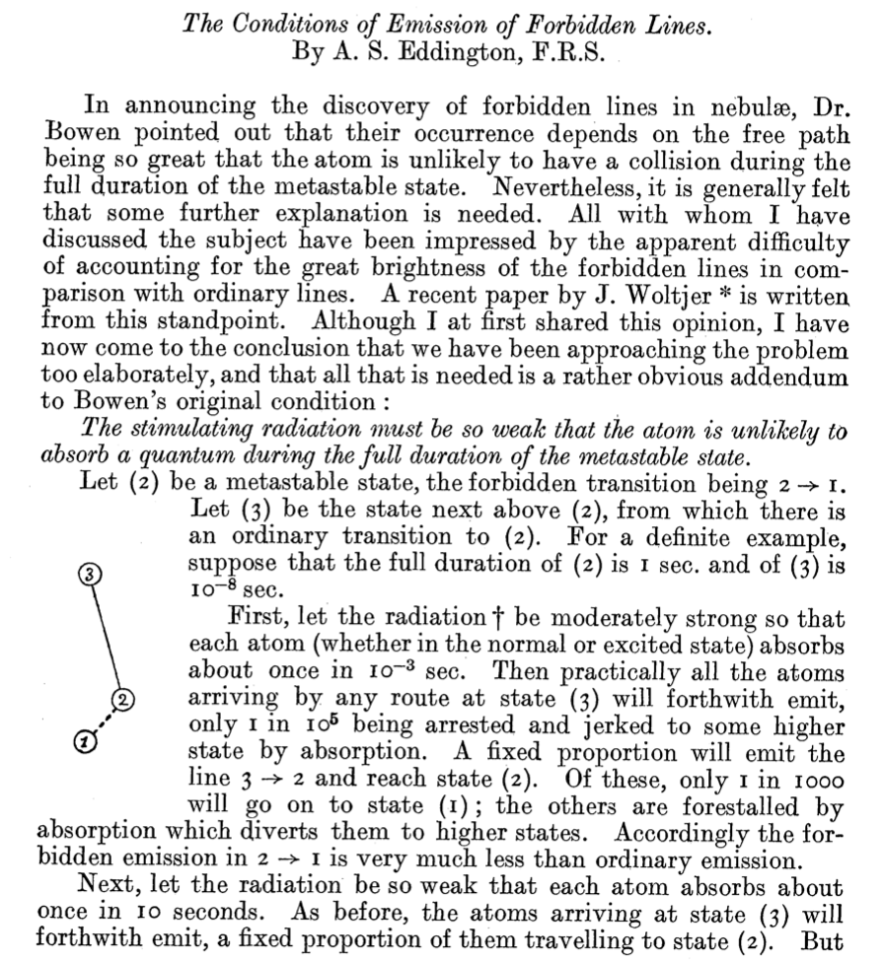
Shards of SHARDS – Science: [OII] and SF
Origin of the [OII] emission?
3 - Stable state
2 - Metastable state
1 - Stable state
Nebulium (1927)
[OII] λ3729
Coronium (1930)
[Fe13+] λ5303
Eddington, A.S., MNRAS, 88, 134-138, 1927

Slide 14
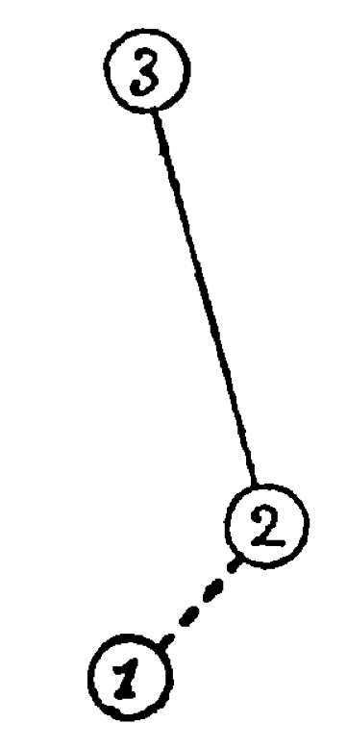
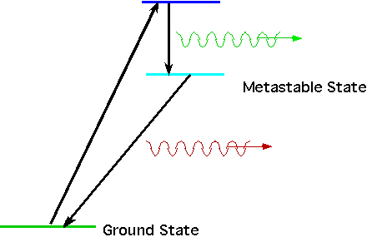
Shards of SHARDS – Science: [OII] and SF
Basic principles of observed emission lines
(modern view, 2013)
Forbidden emission lines have only been observed in extremely low-density gases and plasmas.
Eddington, A.S. - 1927
Modern view - 2013
Even the hardest laboratory vacuum on Earth is still too dense (e.g. >10³cm⁻³ at CERN) for forbidden line emission to occur before atoms are collisionally de-excited.
However, in space environments, densities may be only a few atoms per cubic centimetre (e.g. ~10^⁻¹cm⁻³ in interstellar space, or 10⁻³ in intergalactic space), making atomic collisions unlikely.
Under such conditions, once an atom or molecule has been excited for any reason into a meta-stable state, then it is almost certain to decay by emitting a forbidden-line photon.
O[II]3726Å O[II]3729Å
Since meta-stable states are rather common, forbidden transitions account for a significant percentage of the photons emitted by the ultra-low density gas in space. Forbidden emission lines can become the most luminous observable lines.

Slide 15
Shards of SHARDS - Science: ELGs
SHARDS was optimized for the study of R&D galaxies but ELGs were also within the goals of the survey
[OII]

Slide 16
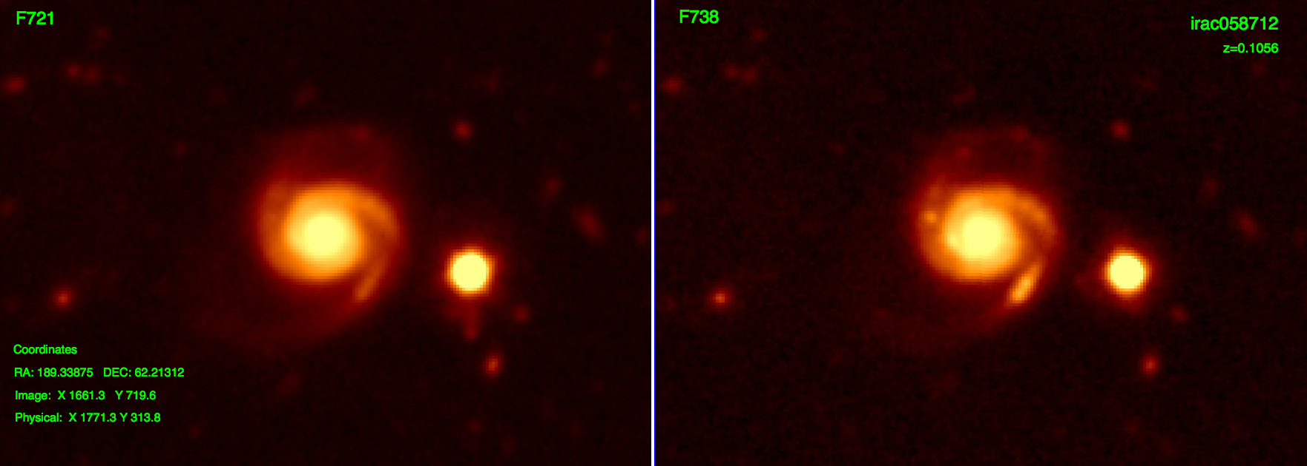
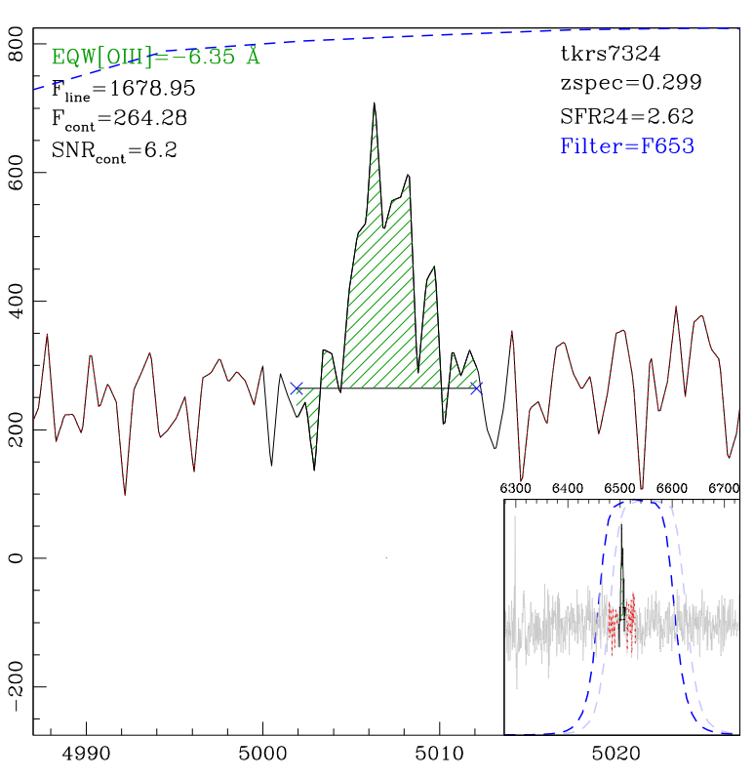
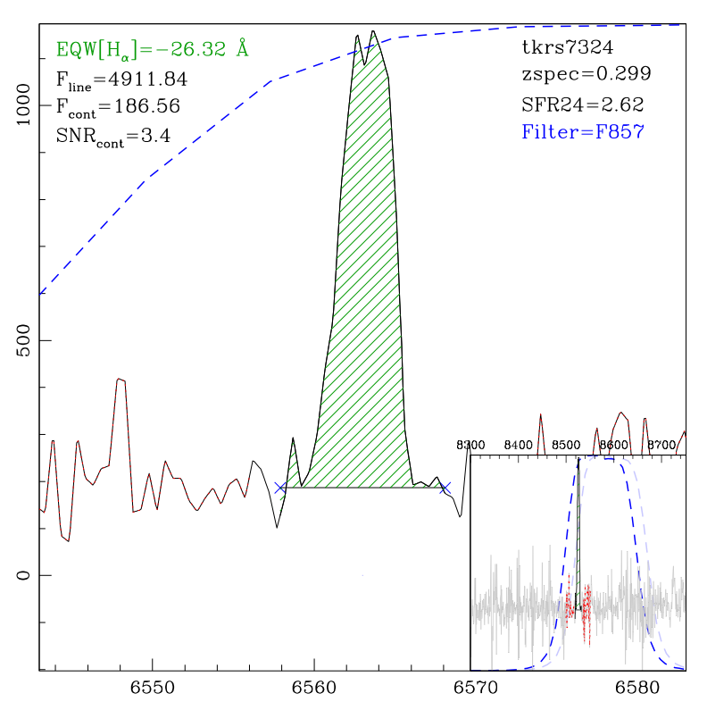
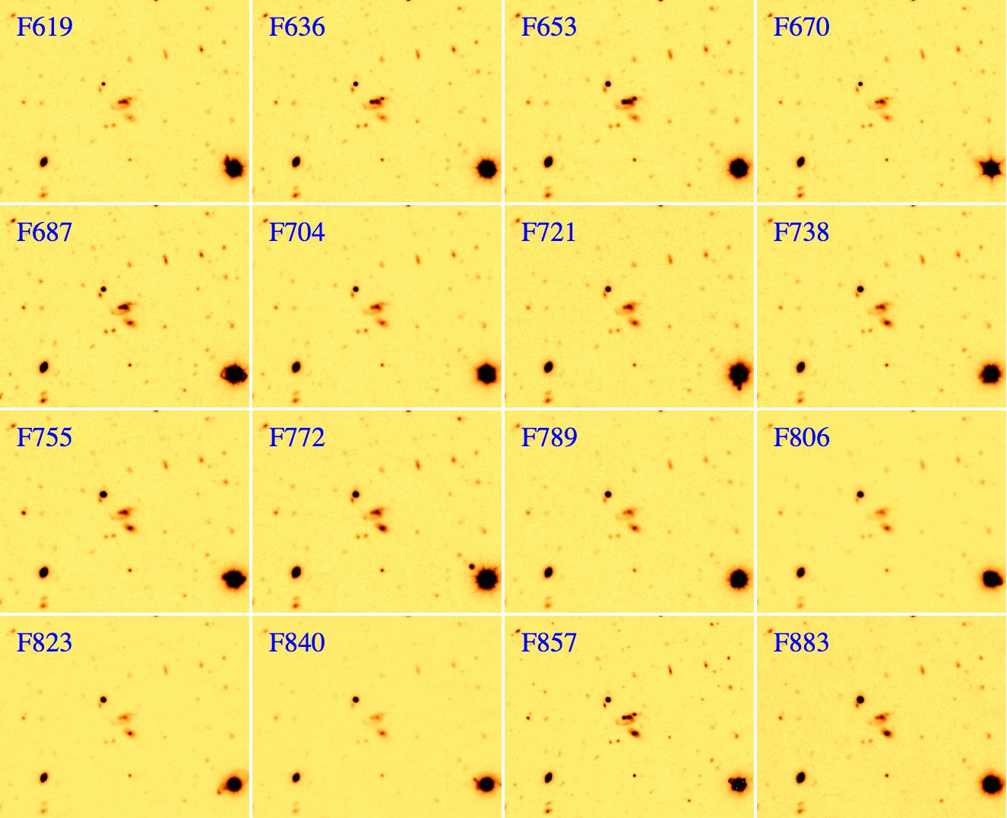
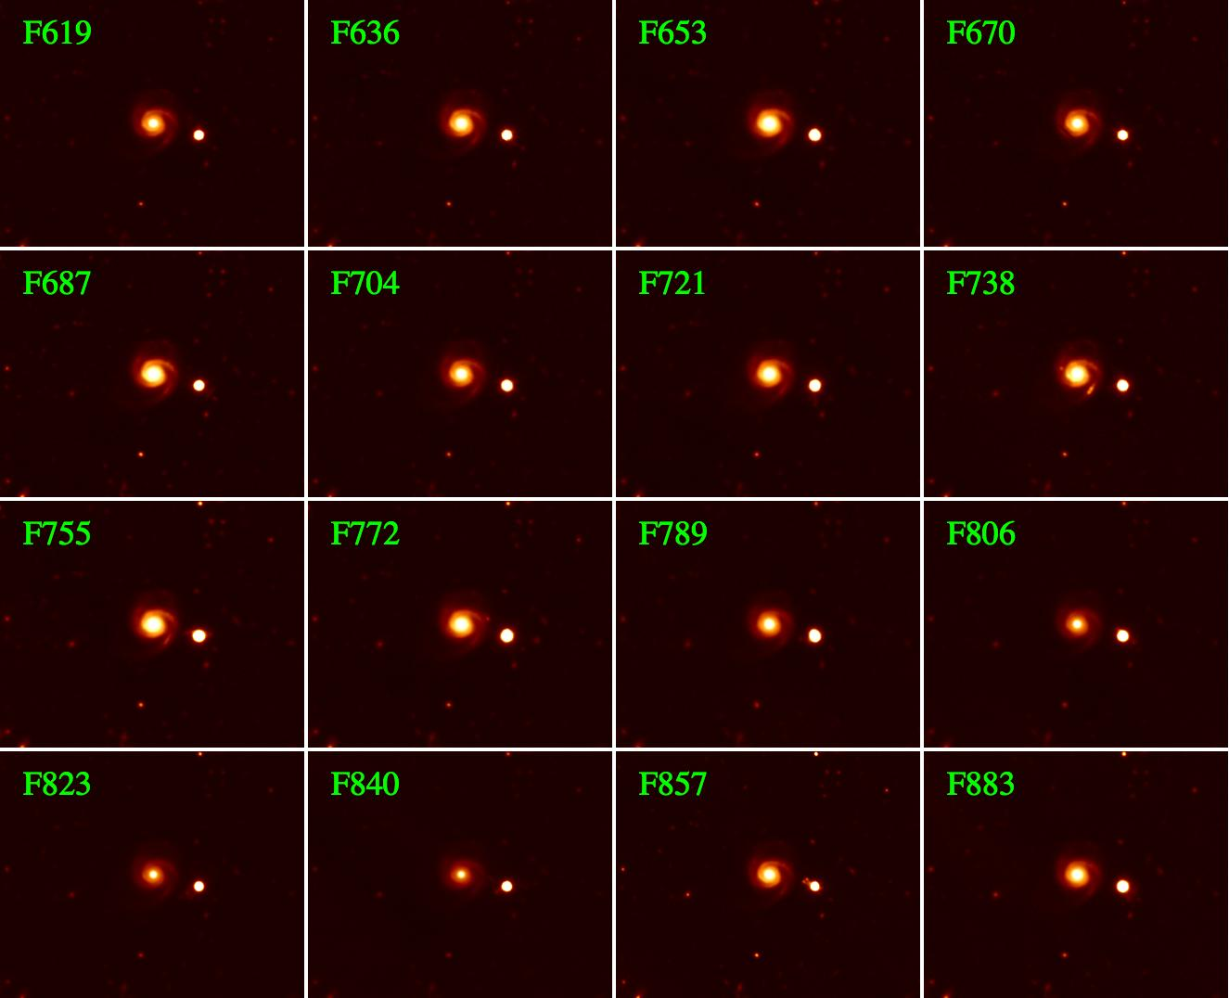
Shards of SHARDS - Science: ELGs
RAINBOWFICATION
directly in the images
Hα expected at F721
Ghost effects removal
and characterization

Slide 17
SHARDS: ELGs selection
Adopting conservative limits:
- filter mag <= 26
- 3-sigma cuts

Slide 18
SHARDS: ELGs distribution
Redshift distribution for emitters in filter F687W17
N
Redshift

Slide 19
SHARDS: ELGs selection
SELECTION FUNCTION
Not a simple redshift interval but depending on the
CWL calibration curve.

Slide 20
SHARDS: ELGs selection

Slide 21
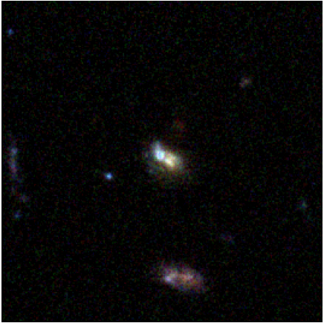
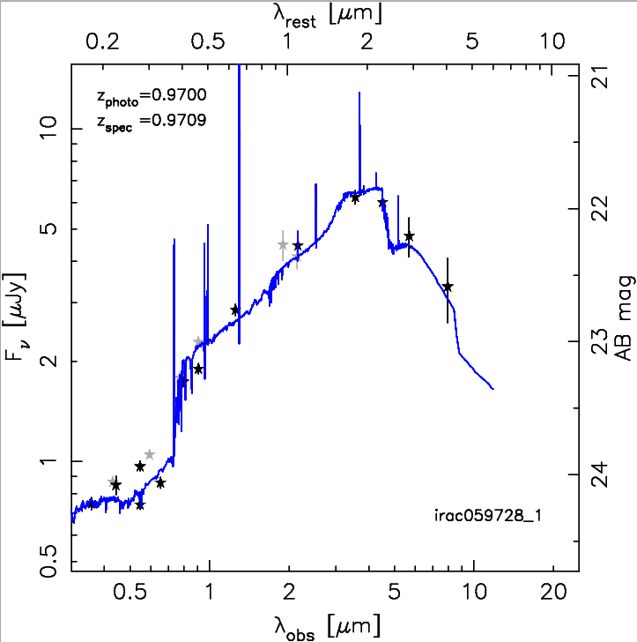
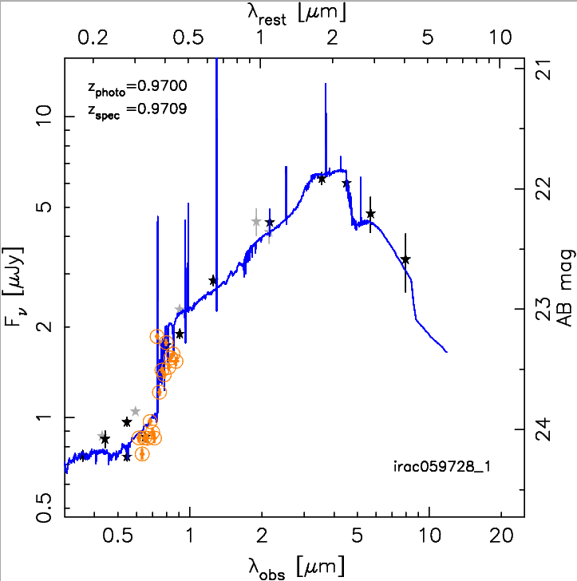
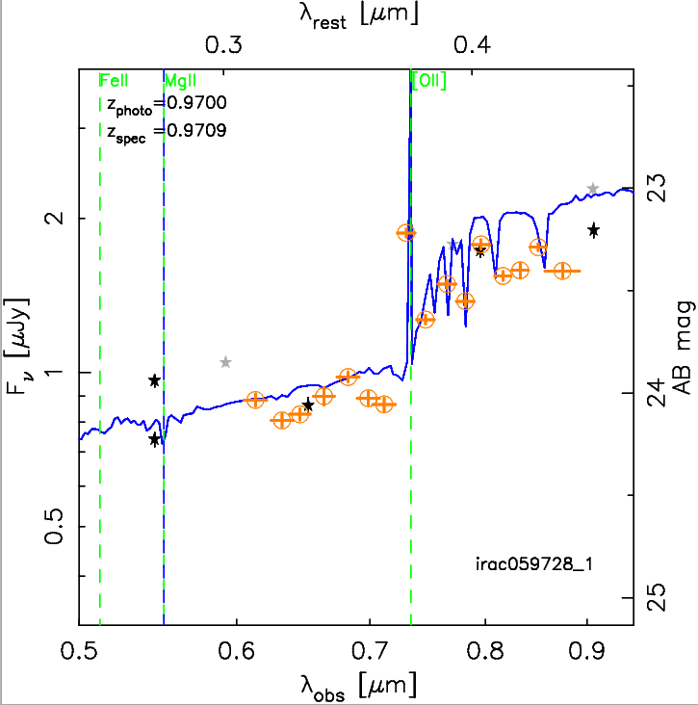
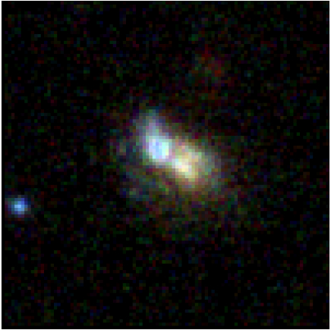
SHARDS: Science - ELGs
7”x7”
3”x3”

Slide 22
SHARDS: Science - ELGs
Using public spectra we check EWs and fluxes for SHARDS emitters:
[OII]
[OIII]
H_{α}
H_{β}
A deeper check including 13 emission and absorption features with a selfconsistent method (from Fritz et al. 2007) providing robust measurements and errors estimation is planned.

Slide 23
SHARDS: Science - ELGs
1:1
We refined the comparison by:
using optimal aperture for each galaxy
adopting continuum fit definition from SED fit to SHARDS data
- aperture effects
Factors affecting SHARDS to Spec line flux correlation:
- spectral flux calibration

Slide 24
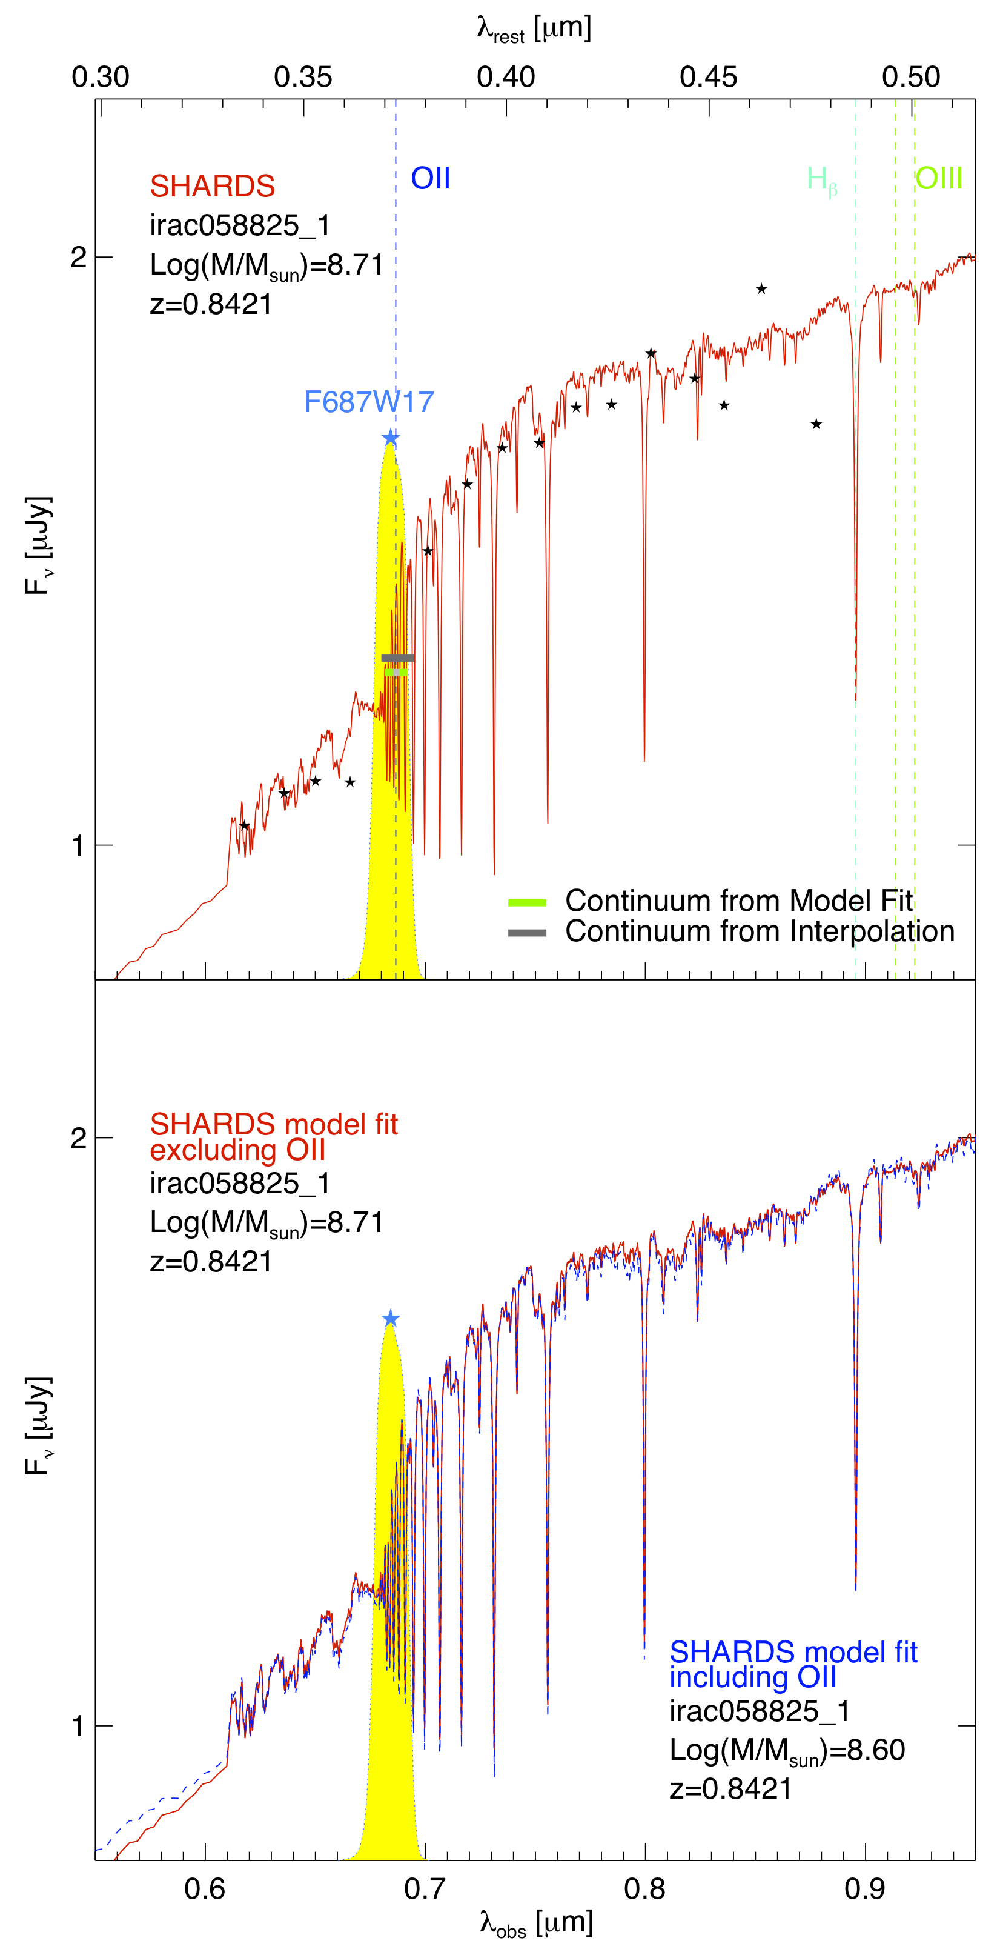
SHARDS: Science - ELGs
1:1

Slide 25
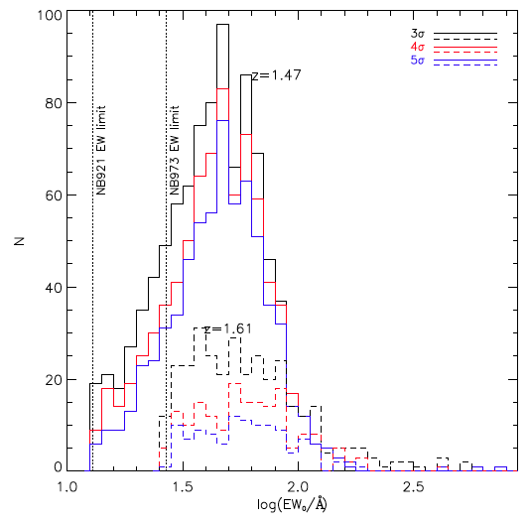
SHARDS: Science - ELGs
Ly+2012
Comparing to recent works we start to be more confident

Slide 26
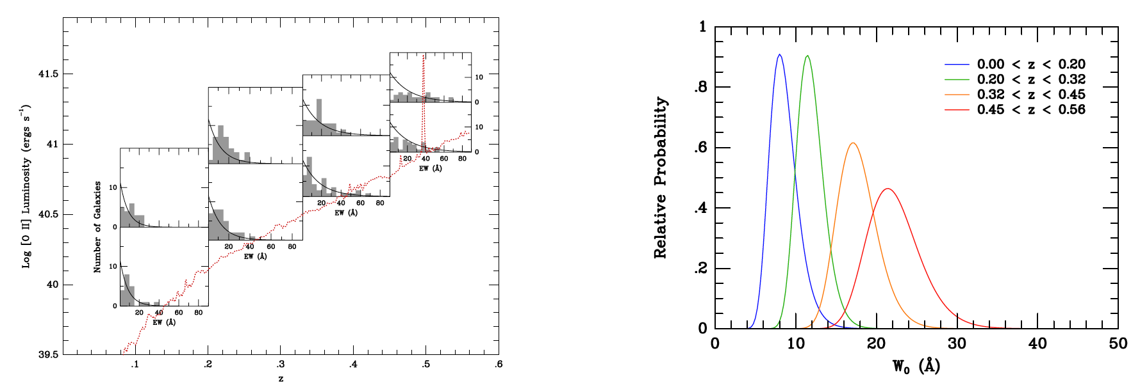
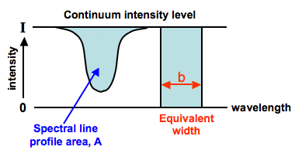
SHARDS ELGs: EWs and SFRs
EWs offer a quick way of examining the relative importance of SF as a function of time
[OII] flux measures the amount of SF in recent past (t<20Myr), while the continuum underlying the 3727Å reflects SF over a longer timestale (t~1Gyr) thus:
EW=F_{[OII]}/I_{cont}
can provide an estimation for the SF efficiency at a given z.
0.75 < z < 0.9
A=I×b
SHARDS ?
(from Ciardullo+2013)
Over the past ~5Gyr, the relative intensities of individual starbursts has decreased linearly with time.
In the local neighborhood, the distribution on [OII] λ3727 rest-frame equivalent widths peaks near ~5Å and show redshift evolutution .

Slide 27
SHARDS ELGs: EWs and SFRs
EWs offer a quick way of examining the relative importance of SF as a function of time
Over the past ~5Gyr, the relative intensities of individual starbursts has decreased linearly with time → but possible FLATTENING AT z~1 consistently with Madau plot : EW~(1+z)^{α}

Slide 28
SHARDS: Science - ELGs
Observed flux limit ~5*10⁻¹⁸
Line luminosities
Observed luminosity limit ~10⁴⁰erg/s

Slide 29
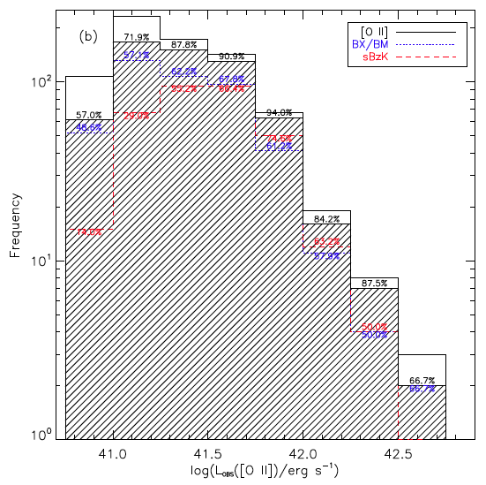
SHARDS: Science - ELGs
We should be able to go even deeper.
Ly+2012
SDF

Slide 30
SHARDS: Science - ELGs
At this point we have all the necessary ingredients to build our observed luminosity function:
EW
number counts
line fluxes
line luminosities
We build the LFs for OII emission line galaxies selected as explained. The selected SHARDS filters are F687W17 and F823W17, whose observed CWLs correspond to redshift bin centered on z~0.84 and z~1.20, two well studied intervals with useful literature camparison data.

Slide 31
SHARDS ELGs: LF at 0.83

Slide 32
SHARDS ELGs: LF at z~1.2
Nonetheless completeness corrections remain quite
an issue due to CWL calibration effects.
Note that:
I adopted conservative limits in the data analysis (m<26,3-sigma) in order to keep completeness issues under control → nonetheless we seem to go as faint as (or more) than any other available narrow/medium band survey
we can gain depth by exploting the full field of view and relaxing the adopted limits → (hopefully 1 mag fainter and 2.5-sigma) increasing statistics

Slide 33
SHARDS ELGs: LF and SFR
Next step is to derive SFRs and analyse SFR/sSFR-Mass reletion and Extinction properties in our sample.

Slide 34
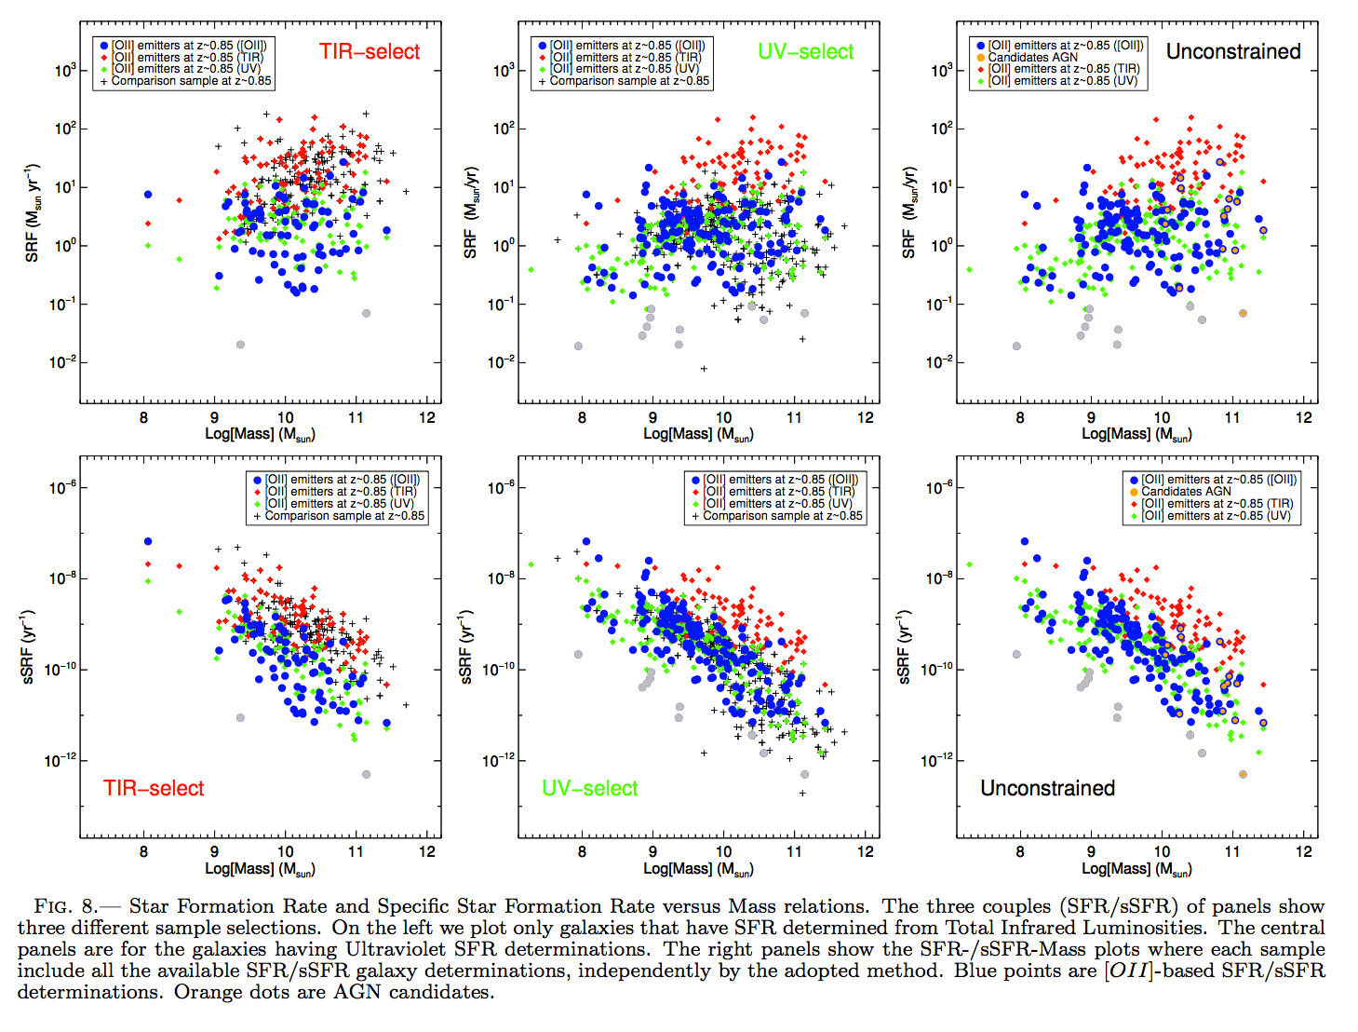
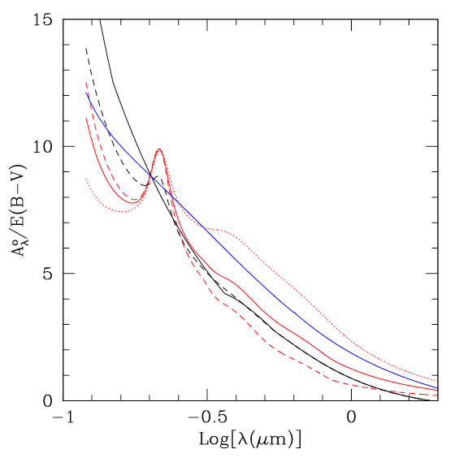
SHARDS ELGs: EWs and SFRs
Cava et al., in prep.
Calzetti 2001
Extinction
Extinction function
SED fitting

Slide 35
SHARDS ELGs: LF and SFR
Extinction corrected SFR

Slide 36
SHARDS ELGs: LF and SFR
F687W17
F823W17

Slide 37
SHARDS ELGs: LF and SFR
F687W17
Most of the points fall below the calibration curve
→ Suggest higher extinction at high-z
F823W17

Slide 38
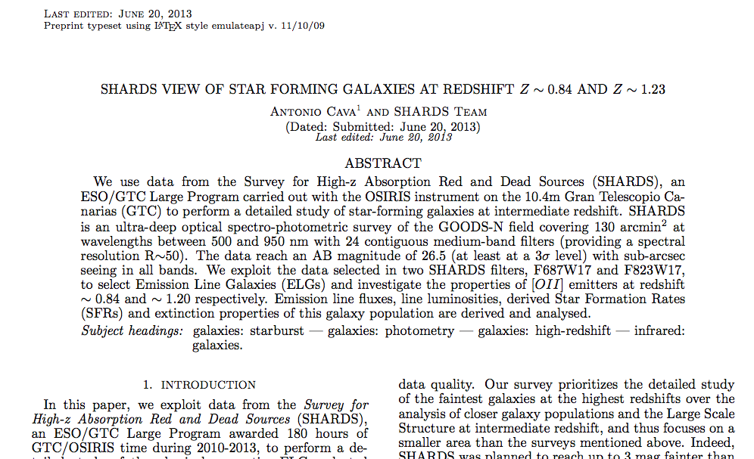
SHARDS ELGs: LF and SFR
More coming soon…

Slide 39
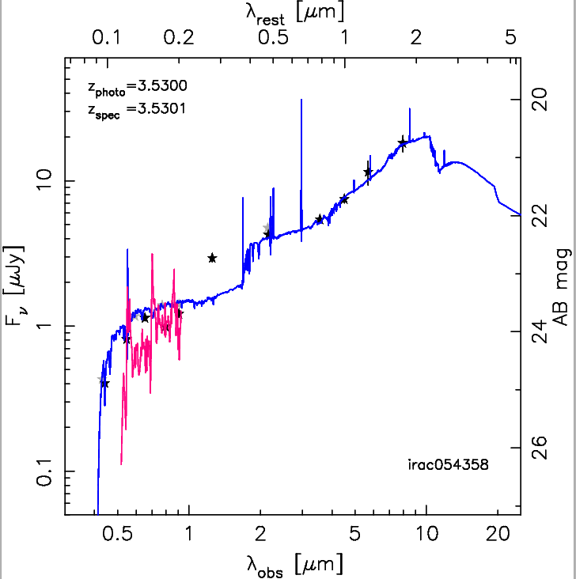
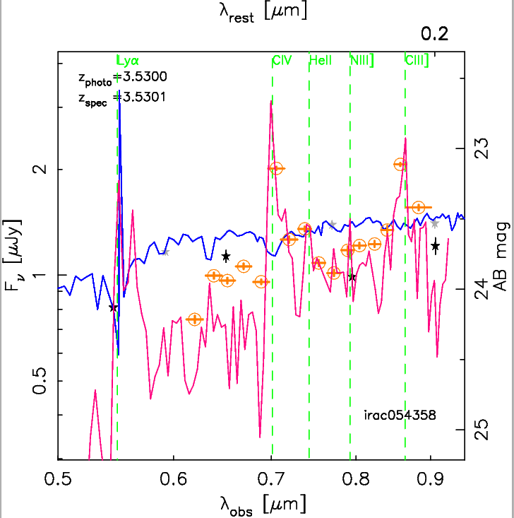
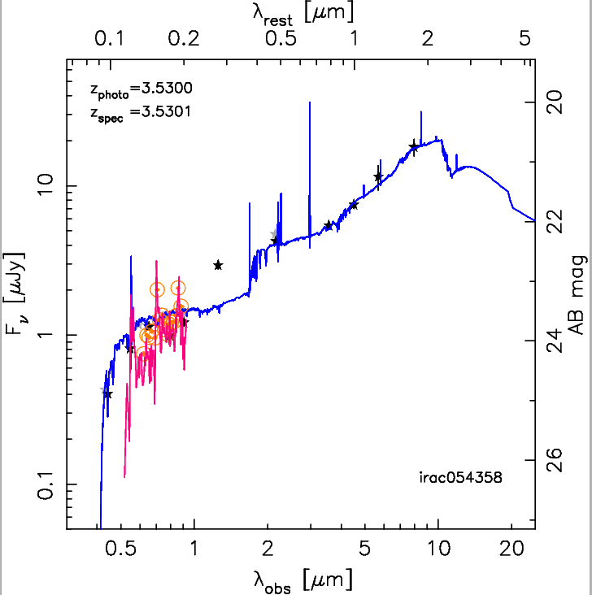
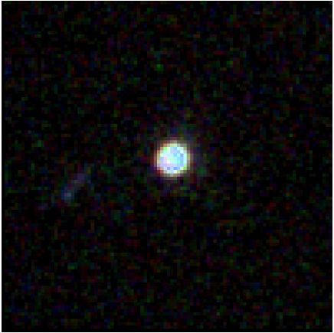
Shards of SHARDS – Science: AGNs
Strong emission lines from AGNs allow us to go at higher redshifts…
SEE Almudena’s talk in the afternoon
ACS
3”x3”
AGN

Slide 40
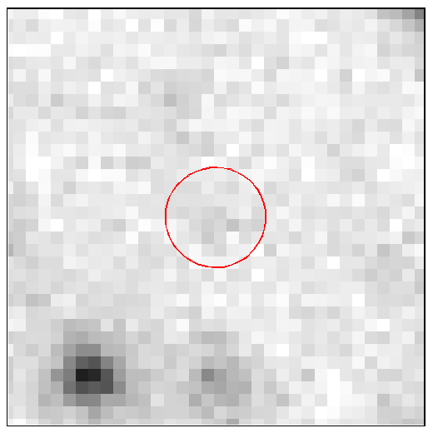
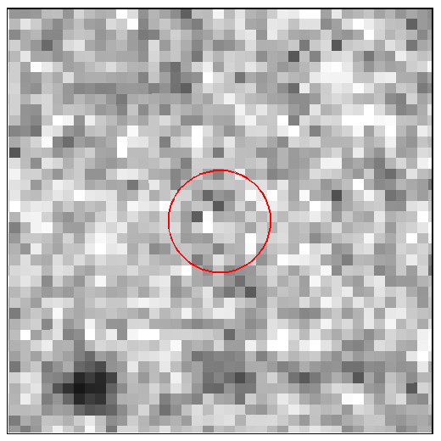
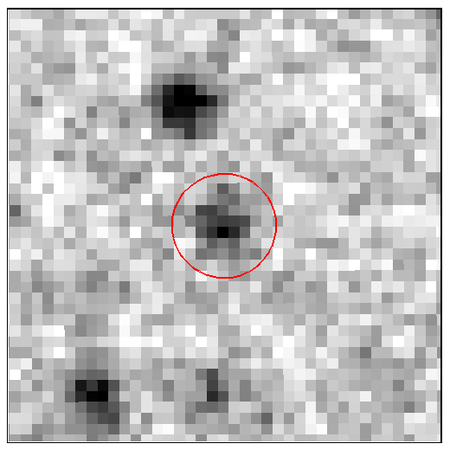
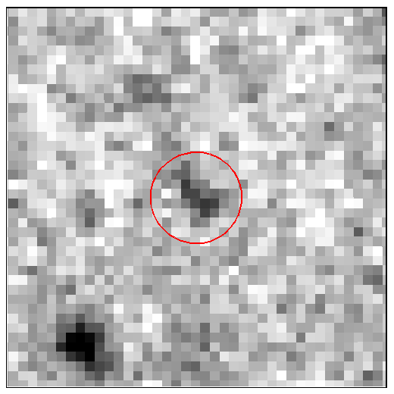
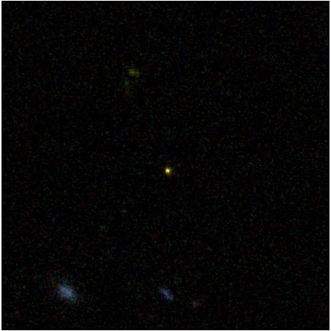
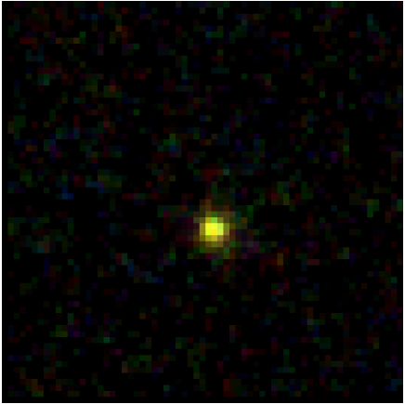
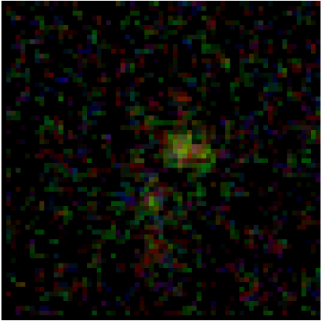
Shards of SHARDS - Science: LAEs at z~5
Subaru R
SHARDS F721W17
SHARDS F738W17
SHARDS F755W17
10”x10”
10”x10”
10”x10”
10”x10”
SEE JoseMiguel’s TALK in the afternoon
10”x10”
3”x3”
3”x3”
ACS
ACS
ACS

Slide 41
SHARDS ELGs: conclusions
- You should be convinced now that a lot of interesting science can be done with SHARDS data and ELGs: SF in intermediate-z galaxies, AGNs, Lyman-a emitters are just few examples
- The project on intermediate-z SF galaxies is in an advanced stage providing very robust resuts about SFRs, sSFRs, Exctintion and their relation with Mass and Redshift
- A first draft will be circulated very soon within the interested group and then to the whole Team, hopefully by (beginning of) July.
- Natural extensions of this projects are needed planned (LFs, complete filter set analysis, …) → see discussion session tomorrow

Slide 42
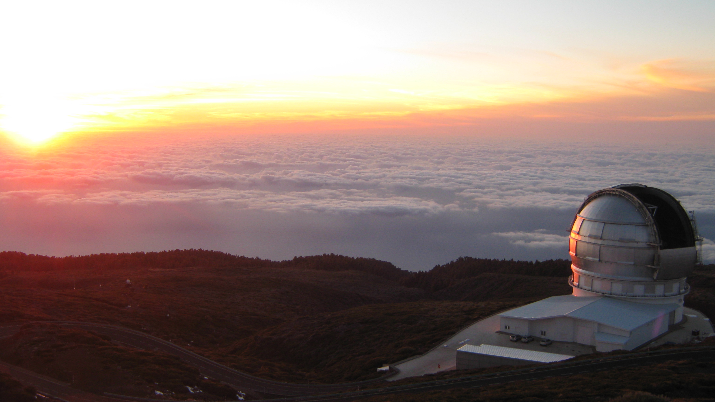
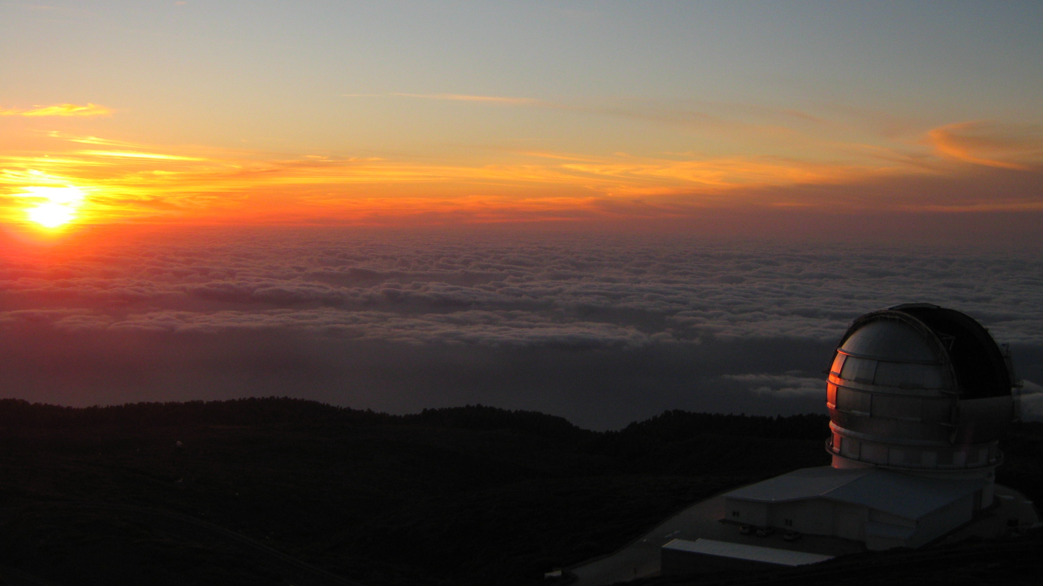
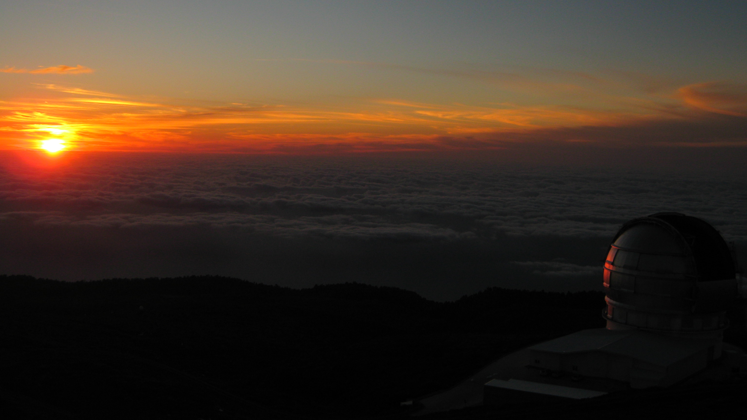
THANK YOU FOR YOUR ATTENTION!!!

